Slide 1
3D Graphics
Project
Yaroslav Yudinskikh
Cristina Popa

Slide 2
01
02
03
04
INTRODUCTION
DETAILS
DEMO
Questions
Small introduction in the project
We will look at the details, what we have done
Live demo of the project
Your questions

Slide 3
Underwater life

Slide 4
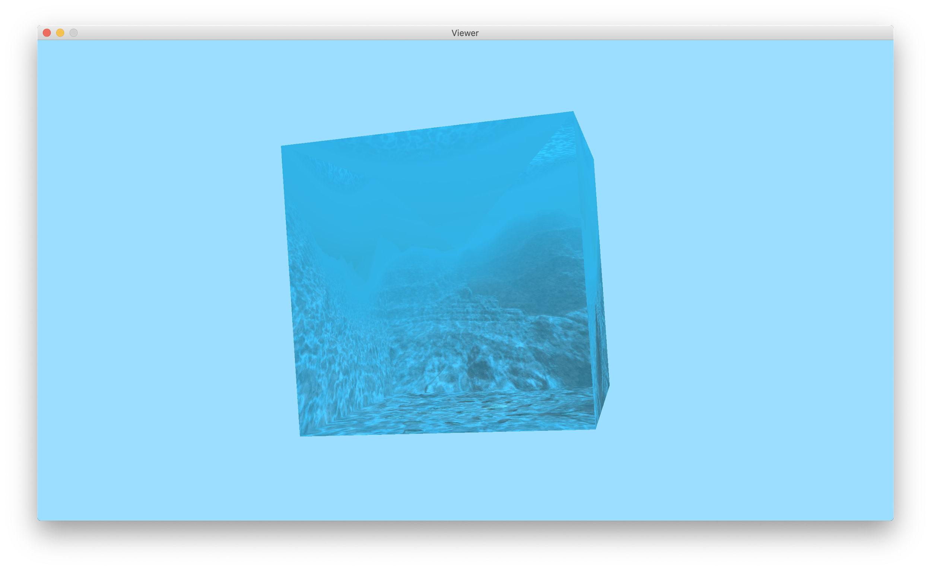
0
SKYBOX
New rendering effect
Texture

Slide 5

01
Fishes
Hierachical
Mesh
Texture
Procedural Animations

Slide 6
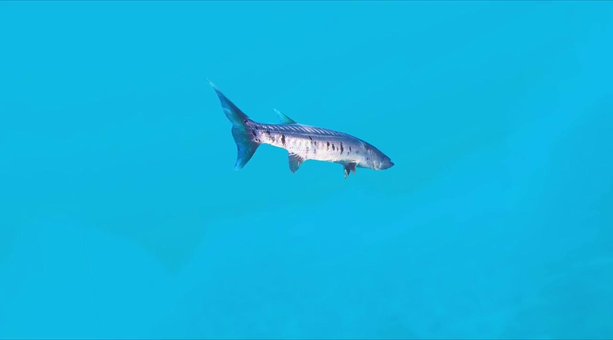
02
Fish again
Keyframe animation
Mesh
Texture

Slide 7
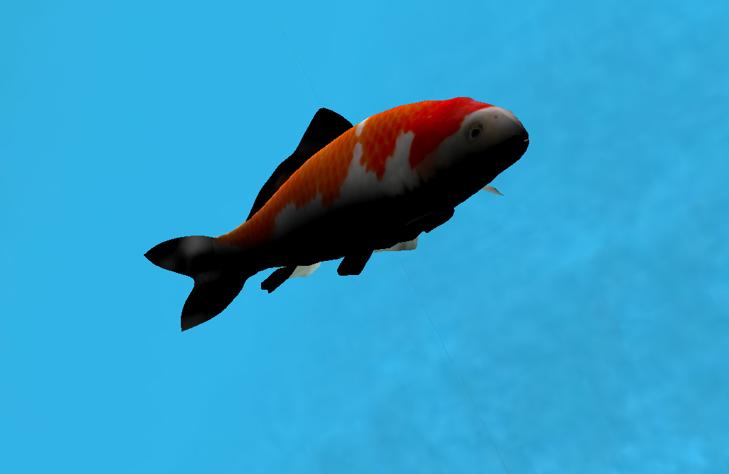
03
Fish again 2
Lights and Materials
Mesh
Texture

Slide 8
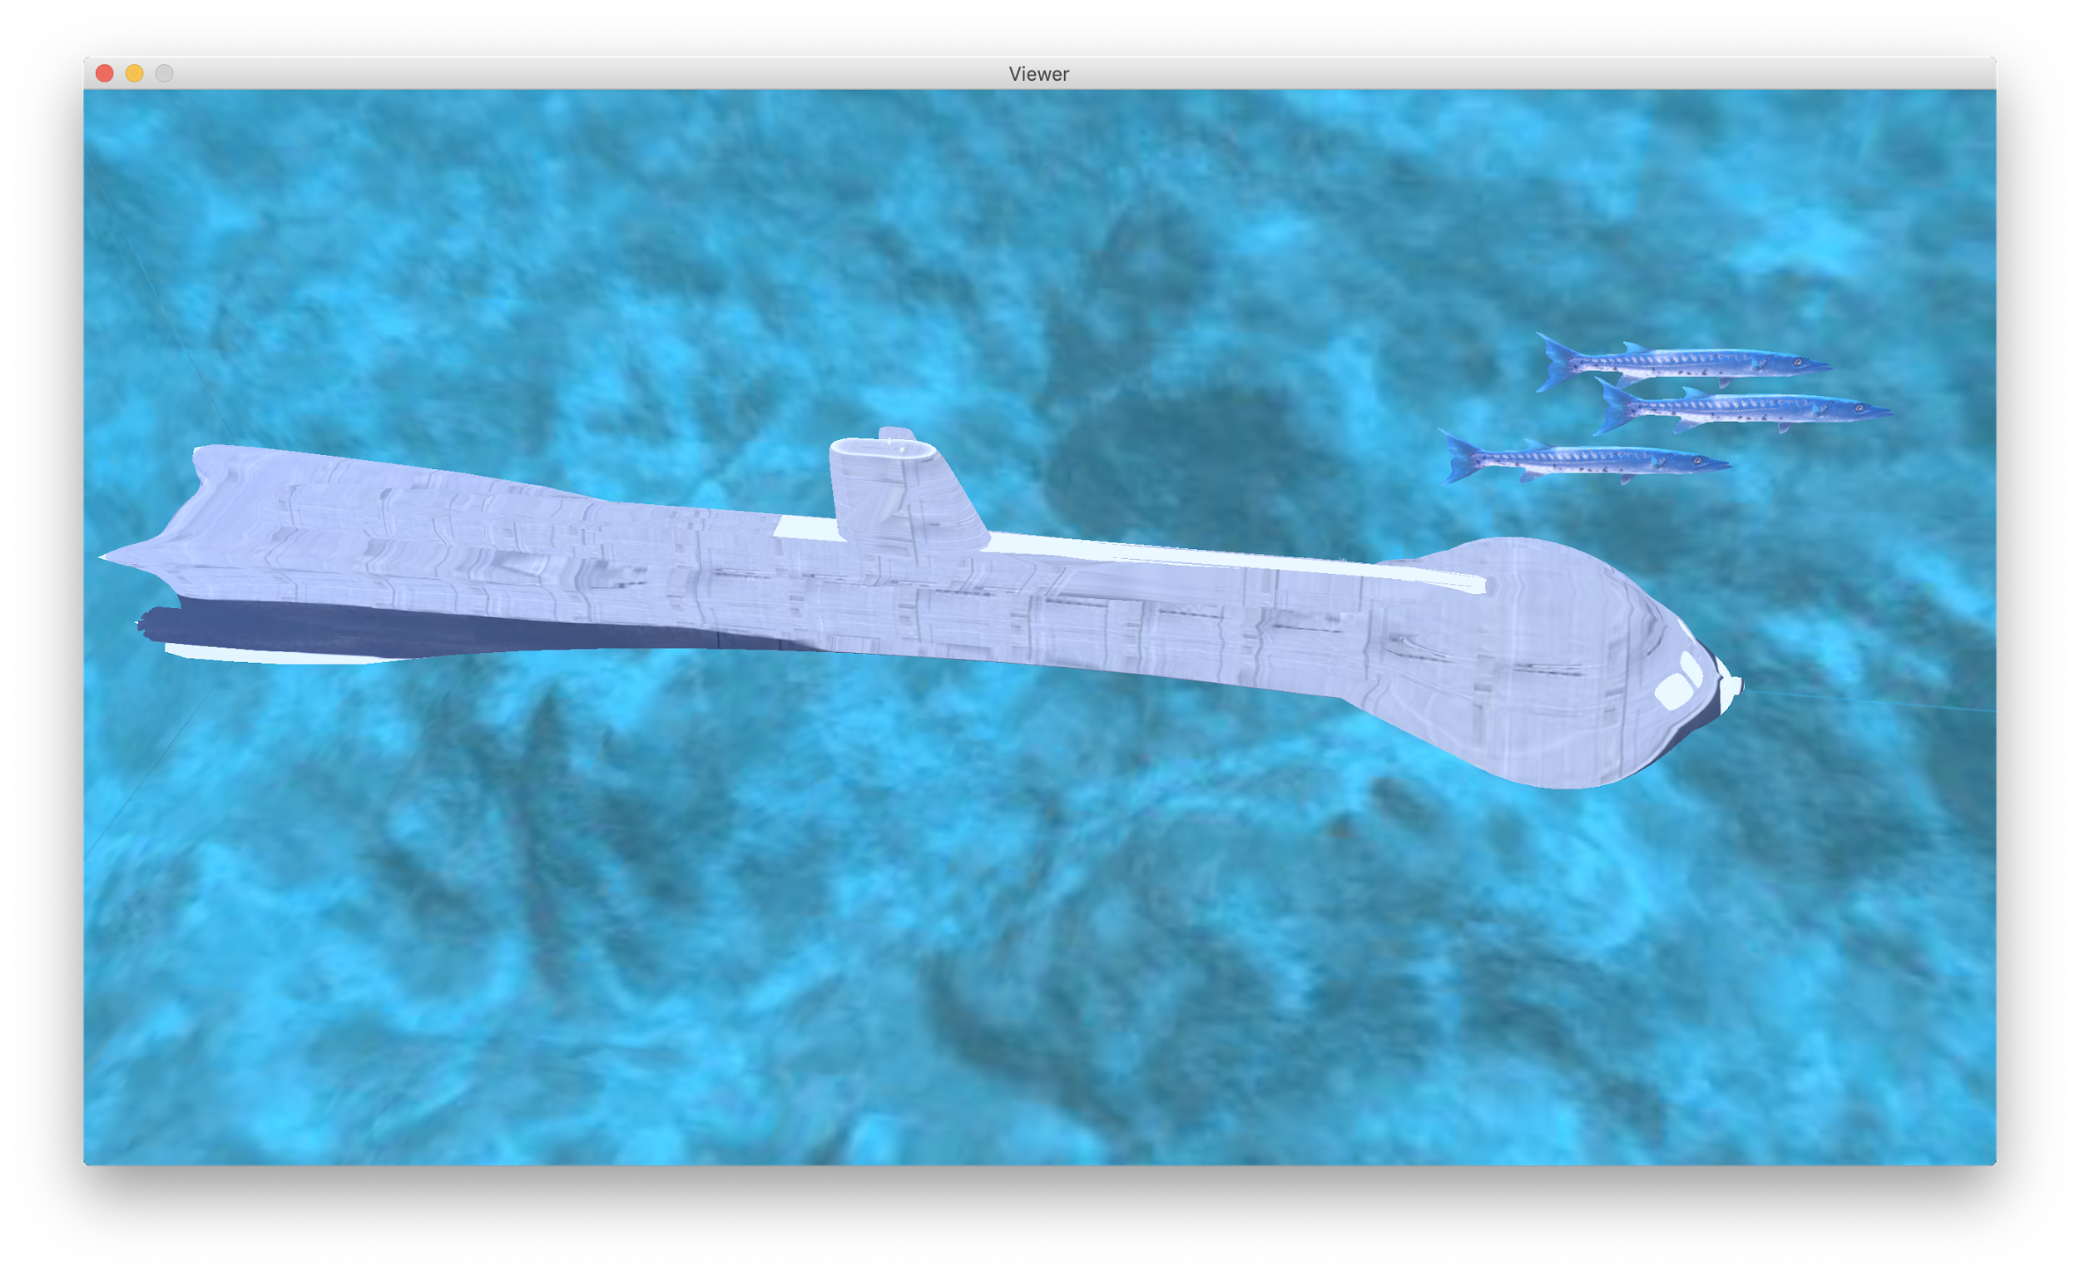
04
Submarine
Control movements by keys
Mesh
Texture

Slide 9
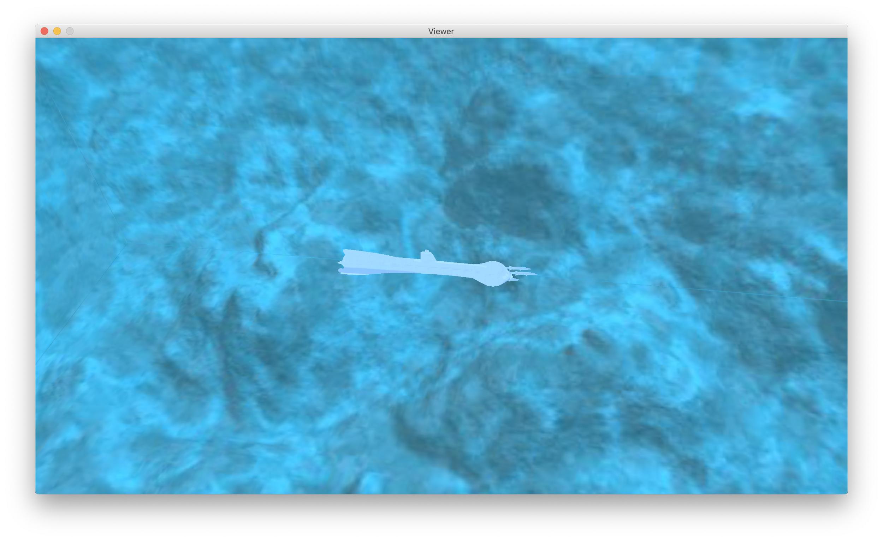
05
Fog
New effect

Slide 10
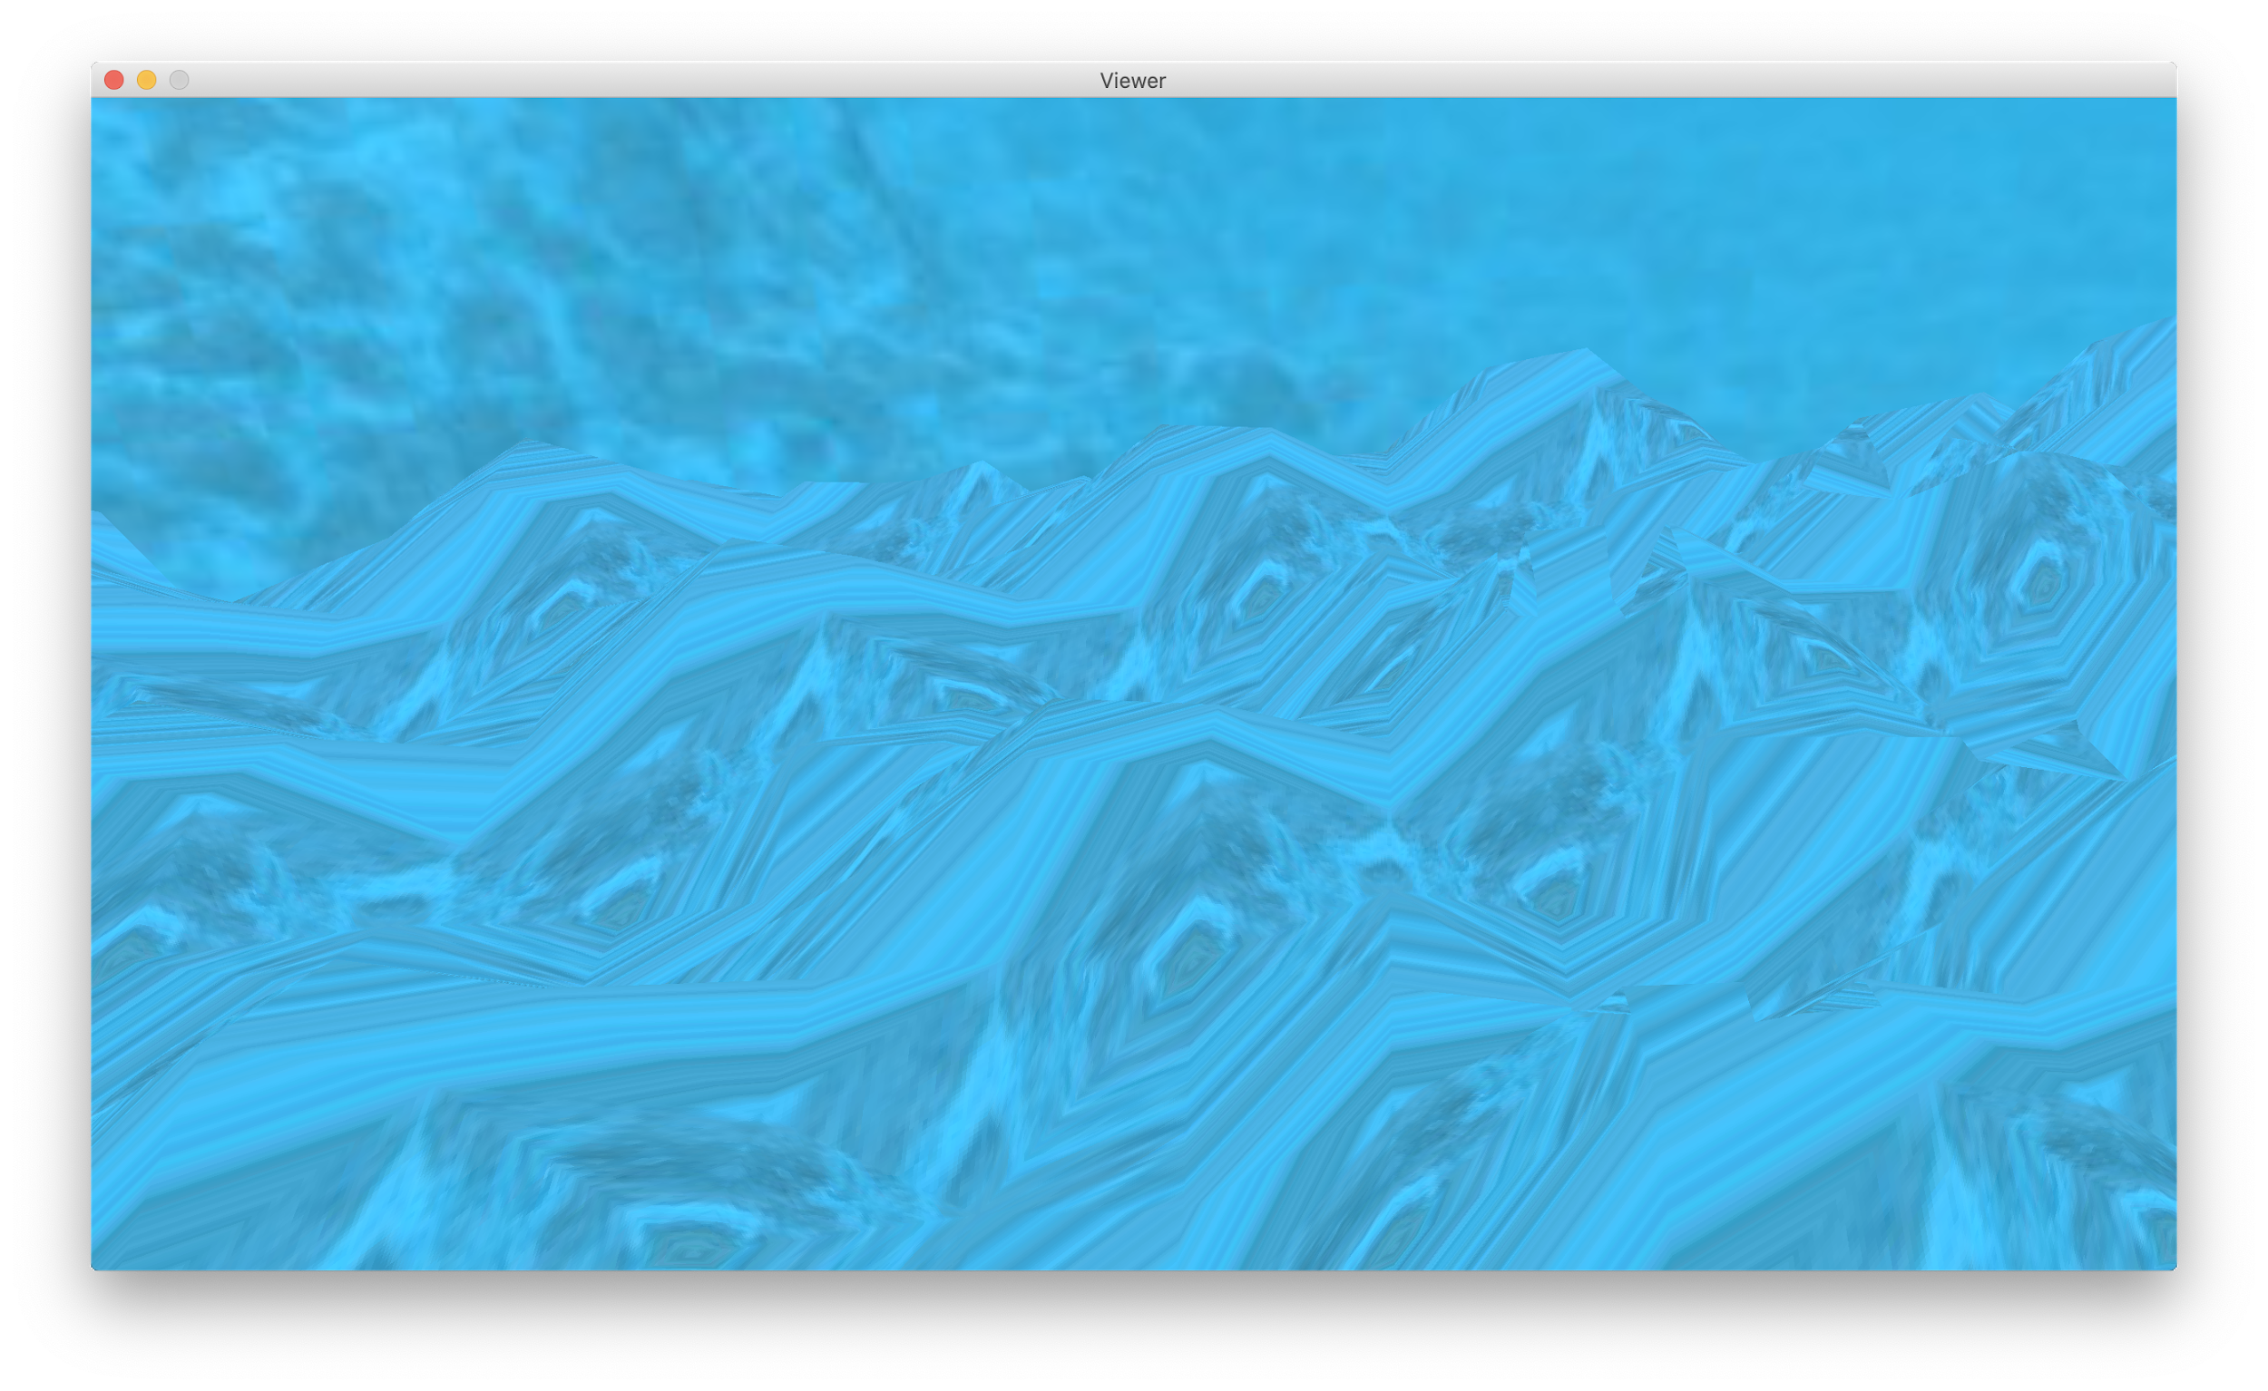
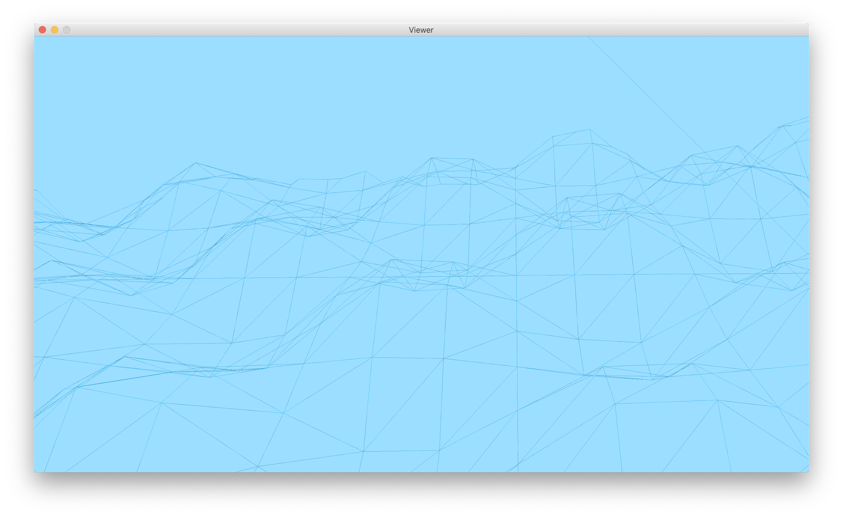
05
Ground
Non-flat ground
y = sin(x) * cos(z)
Mesh

Slide 11
DEMO TIME

Slide 12
Questions?

Slide 13

Thank you for attention and this course!
Made by students, spring 2020
Cristina Popa Yaroslav Yudinskikh

